Slide 1
Air National Guard
AGR Training

Slide 2
Contents
AGR Program Overview
Work Schedules
Types of AGR Tours
Tour Curtailment, Separation, and Retirement
Sanctuary
Leave/Passes
Off Duty Employment
AFSC Requirements
Controlled Grades

Slide 3
AGR Program Overview
The AGR Program consists of Active Guard Reserve (AGR) Full-Time Support (FTS) personnel who are responsible for assisting in the organization, administration, recruitment, instruction or training of ANG personnel and assigned primarily against mobility positions
Governing instruction: ANGI 36-101, AGR Program
Manning document Resource Identification Code (RIC) codes: Enlisted-148; Officer-0034

Slide 4
Work Schedules
AGR Airmen will perform a minimum of 40 hours of duty per week
Regular or alternate work schedules for AGRs, as approved by workday policy
AGRs are required to participate in UTAs. If excused these members must be in leave status
UTA does not count toward the 40 hour work week
AGRs are accessible 24 hours a day, 7 days a week and do not qualify for compensatory time off

Slide 5
AGR Tours
Initial Tour:
Also referred to as the probationary tour
NTE 6 years (3 years for ID)
Continuation Tour or tour renewal:
Makes the individual career status
Usually 1 to 6 years in length (NTE 6 years)
Cannot exceed the current ETS date
Cannot exceed AGR retirement eligibility date
Occasional/Deployment Backfill Tours
Minimum of 31 consecutive days

Slide 6
AGR Tour Curtailment, Separation, and Retirement
Voluntary Tour Curtailment:
Usually must serve 24 months of current assignment before release is approved
May request release from tour based on personal hardship or other valid reason through chain of command through HRO to TAG
Involuntary Tour Curtailment:
Commander will work with HRO to determine if appropriate
Involuntary Release:
Mission realignments, BRAC, end-strength limitations or other force management actions may cause an involuntary release from the AGR program

Slide 7
AGR Tour Curtailment, Separation, and Retirement
Mandatory Separation:
Officers must be separated before reaching their maximum years of service
Enlisted members will be separated upon reaching age 60 unless they have completed 18 to 20 years of service
Retirements:
AGRs may apply for an active duty retirement one year prior to completion of at least 20 years of total active military service
Applications for retirement must be submitted NET 12 months and NLT 6 months prior to the effective date of retirement

Slide 8
Sanctuary
18-20 years of active federal military service
AGR officers reaching sanctuary must be retained until reaching retirement eligibility
Secretary of the Air Force is final authority for separation of officers in this zone
Enlisted entering sanctuary zone for regular retirement should be retained until retirement eligible; however, TAG may involuntarily separate enlisted Airmen for cause

Slide 9
Leave/Passes
The provisions of AFI 36-3003, Military Leave Program apply to AGR personnel
Leave requests are submitted through LeaveWeb and approved by Commanders unless delegated to a level no lower than first line supervisor
AGR members earn 2.5 days of leave every month
Members may not carry forward a leave balance of more than 60 days into a new fiscal year

Slide 10
Leave/Passes
Leave must start and end in the local area
Leave will be charged for duty and non-duty days (example: Friday through Tuesday is a charge of 4 days
Members can sell back no more than 60 days of leave in their career

Slide 11
Leave/Passes
Leave is a right; however, unit commanders can deny leave due to military necessity
Pre-separation or retirement relocation activity: Members may be approved up to 20 days of permissive TDY specifically to house hunt or job search. This is permissive TDY and should be used in accordance with the regulation (job search or house hunting)
Normally do not charge leave to members undergoing treatment for an infectious or contagious disease (flu, pink eye, strep throat, etc)
Ordinary leave is charged to members for work days lost due to elective medical procedures (example: cosmetic surgery)
Members are charged ordinary leave for lost work days due to illnesses in the family (example: kids-strep throat or common colds)

Slide 12
Leaveweb

Slide 13
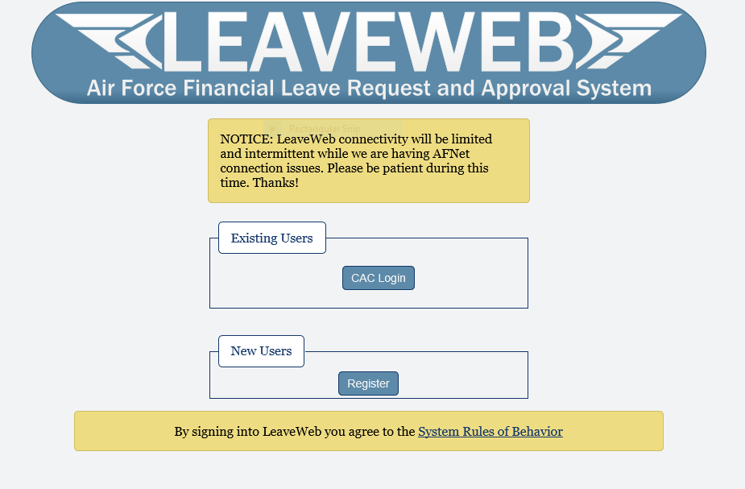
Leaveweb
Active Duty – SSN
MAJCOM - ACC
Base – Offutt
Unit – 114 FW Sioux MXS
Supervisor

Slide 14
Leaveweb
Submit new leave
Approve leave
Return from leave

Slide 15
Leave/Passes
Commanders may award a 3 or 4 day special pass for special circumstances or occasions such as reenlistment, special recognition, or compensatory time off
Award of pass may be used in the following examples: for a Friday through Monday, Saturday through Tuesday
A special pass may be taken in conjunction with leave; however, leave cannot be taken both before and after the pass.
Commanders should not grant special passes in succession

Slide 16
Off Duty Employment
Commanders must ensure off-duty employment is in compliance with DoD Directive 5500.7, Standards of Conduct
Commanders must maintain a copy of written approval for all AGR Airmen on AF Form 3902, Application for Approval for Off-Duty Employment

Slide 17
AFSC Requirements
The intent of the AGR program is to assess AFSC qualified individuals; however, any applicant selected who does not possess AFSC, must sign an agreement to retrain
If member requires retraining the following statement must be included in the AF 2096:
“I acknowledge that I will attend the first available course that would qualify me in the new AFSC. I will complete the course successfully and progress in training to a skill-level compatible with my UMD assignment. Failure to do so will result in the termination of my AGR tour.”
Individuals must continue to progress in training to skill-level compatible with their UMD assignment. Airmen who do not progress will be removed from AGR status

Slide 18
Controlled Grades
Congressionally mandated end-strength authorizations for SMSgt, CMSgt, Major, Lt Col, Col
Approved upon the signature of the NDAA
Assignment and promotion cannot exceed the annually established military duty end-strength or grade ceilings
A member must sit in the UMD authorization and have a controlled grade available before promoting (a Major may be sitting in a Lt Col UMD position but cannot be promoted until a controlled grade is available)

Slide 19
QUESTIONS

