Slide 1
How to Access DCPDS

Slide 2
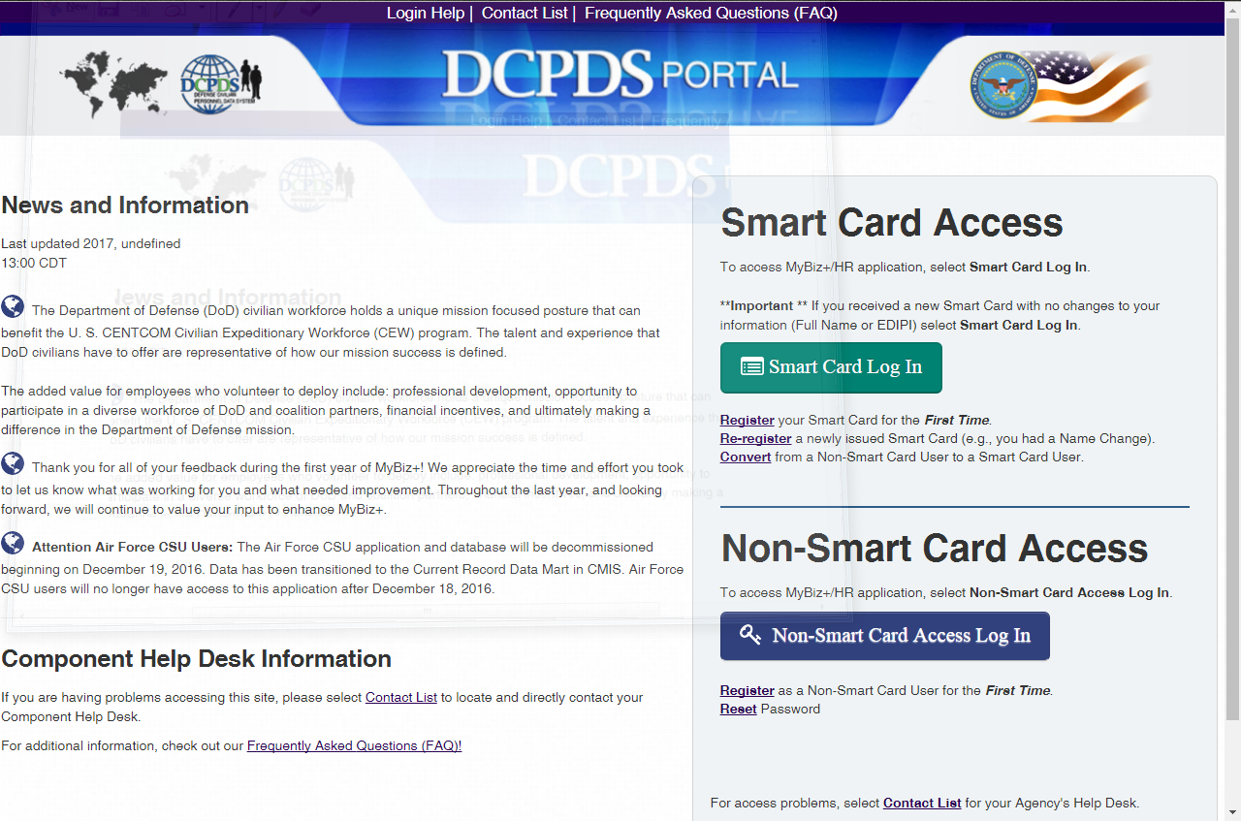
Step 1: Access Portal
Go to: https://compo.dcpds.cpms.osd.mil/

Slide 3
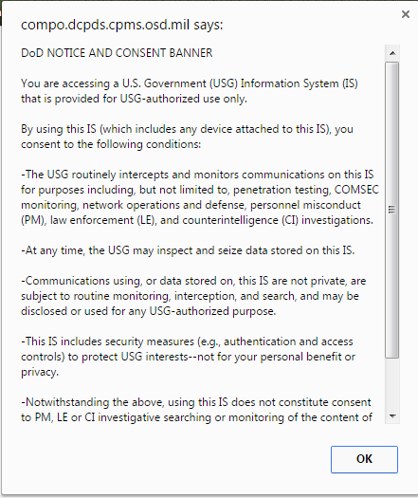
Step 2: Accept the DoD Notice Banner

Slide 4
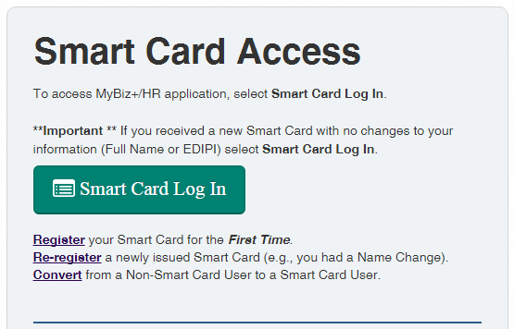
Step 3: Register Smart Card Access (CAC)
First time users click register.

Slide 5
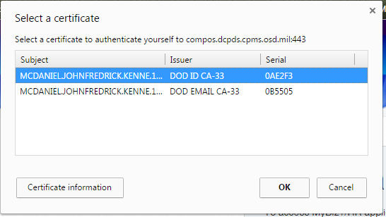
Step 4: Select Certificate
Select your DoD ID (not email)
Click on your DOD ID and then click OK.
Don’t select your DoD Email

Slide 6
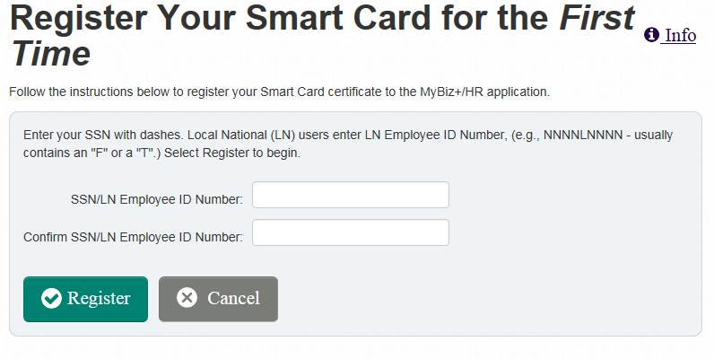
Step 5: Register w/ SSN
Step 1: Type your SSN with dashes.
Step 2: Click register.

Slide 7
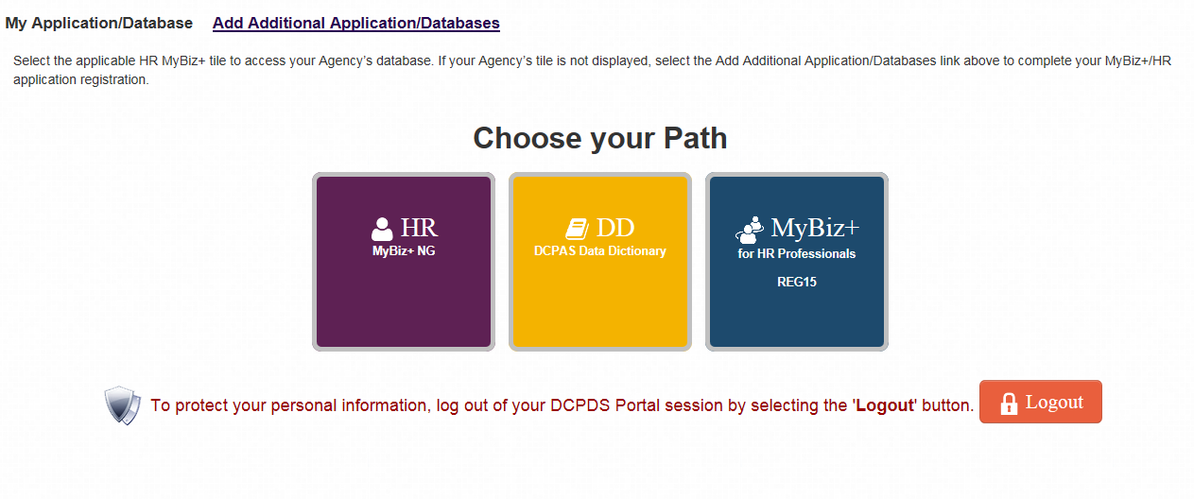
Step 6: Choose Path If you do not see this, continue to next slide.
Registration complete. Click HR (MyBiz+NG)

Slide 8
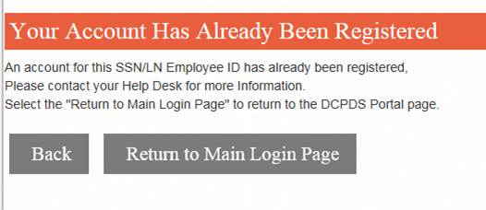
Step 6: Account Already Registered If you receive this error message:
If your account has already been registered, click Return to Main Login Page.

Slide 9
Step 7: Add Additional Application
Click Add Additional Application/Databases.

Slide 10
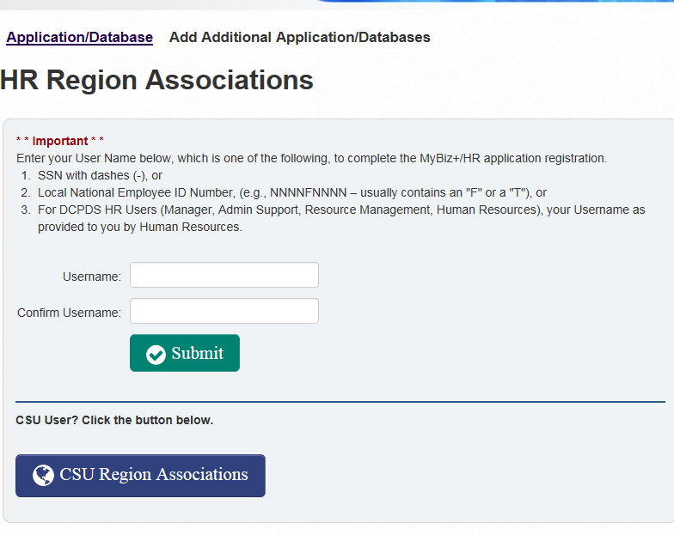
Step 8: Update HR Region
Step 1: Type your SSN with dashes (Twice).
Step 2: Click Submit

Slide 11
Step 9: Choose Path
Registration complete. Click HR (MyBiz+NG)

