Slide 1
National Guard Technician Performance Management (TPR 430 05 Nov 09) and Performance Appraisal Application ( PAA )

Slide 2
Overview
What Changes
What Does Not Change
Performance Appraisal Process
Description of Responsibilities
Critical Elements & Self Assessments
Brief Look My Biz & My Workplace
Specific to Idaho Information

Slide 3
Performance Management What Changes
Mandatory use of the NGB Form 430, Performance Appraisal, to be used with My Biz & My Workplace (IDNG 430-1-R obsolete)
Annual Appraisal Cycle: 1Jan – 31Dec for all Technicians
New Terms:
Performance Appraisal Application(PAA)
Critical Element is a Job Objective
Employee Self Assessment
Rating Official Assessment
Higher Level Reviewer
Notes:
TPR 430, para 2-1 states: “The appraisal period will be on an annual basis with the appraisal year; normally October 1 through September 30 each year.” *States have the flexibility to establish another appraisal period after negotiating with their bargaining unit.
Appraisal Cycle: Annually 01 January – 31 December (Although TPR 430 recommends 1Oct-30Sep)
New Terms:
PAA – Performance Appraisal Application Tool
Critical Element is called Job Objective
Employee Self Assessment
Rating Official Assessment
Higher Level Reviewer

Slide 4
Performance Management What Changes
Mandatory Five Level Evaluation Method
Level 1 thru Level 5 (See Table 2-1, pg 9, TPR 430)
5 - Outstanding
4 - Excellent
3 - Fully Successful
2 - Marginal
1 – Unacceptable
Notes:
TPR 430, National Guard Technician Performance Appraisal Program:
Requires all States to comply with the new TPR 430, the Five Rating Level Evaluation Method
Summary Level Pattern: 5 Levels (Level 1 = Unacceptable; thru Level 5 = Outstanding)
One Mandatory Interim Review: documented in the Performance Appraisal Application Tool
Mandatory Supervisory Critical Element
Close Out Assessments: Narrative assessment used in the final annual rating of record.
New NGB Form 430, Performance Appraisal: electronically generated in DCPDS, MyBiz/MyWorkplace

Slide 5
Performance Management What Changes
Mandatory Interim Review
Journal Page
Automatic Email
Tracking System for Performance Management
PAA accessed through MyBiz and MyWorkplace
Advise having 3-5 Job Objectives; allows 10.
Process is built to be Employee driven

Slide 6
Performance Management What Changes
If the period of performance is under 120 days the performance plan may be transferred or closed (call HRO for specific guidance as each situation is different)
Mandatory Supervisory “Critical Element”

Slide 7
Mandatory Supervisor Objective
Execute the full range of human resources including performance management and fiscal responsibilities within established timelines and in accordance with applicable regulations. Adhere to merit principals. Develop a vision for the work unit and align performance expectations with organizational goals. Maintain a safe work environment and promptly address allegations of noncompliance. Ensure EEO/EO principles are adhered to throughout the organization. Ensure continuing application of, and compliance with, applicable laws, regulations and policies governing prohibited personnel practices; promptly address allegations of prohibited discrimination, harassment, and retaliation.

Slide 8
Performance Management What Does Not Change
Plans are created for Trial/Probationary period – it is not considered an official appraisal until after 12 months
Communicating Performance Plans
Providing Assistance to those performing at or below a Level 2
Performance Improvement Plans
Requirement for Closeout Assessments
Appeal Process
No appraisals due on temporary technicians
Notes:
In the Five Rating Level Evaluation Method - What Does Not Change
Trial/Probationary Ratings
Communicating Performance Plans
Below Fully Successful/Unacceptable Performance
Performance Improvement Plans
Appeal Process

Slide 9
Performance Appraisal Process
Planning
Higher Level Reviewer
Supervisor
Employee
Supervisor
Reviews performance plan for equity among employees in same occupation, and salary.
Approves performance plan for employee
Understands mission
Reviews/revises Critical Elements
Uses working Critical Element field on form
Revises Critical Elements
Cuts and pastes into Critical Element field on form
Defines mission
Develops Critical Elements
Uses working Critical Element field on form
F
I N
A
L
Monitoring, Developing, Rating, Rewarding
Self
Assessment
Interim
Review
Self
Assessment
Performance
Appraisal
Rating is the
basis for
personnel
actions.
Notes:
9
Employee Driven Process if desired
Self-assessments and Interim Reviews
Requirement to define a mission statement

Slide 10
Employee’s Responsibilities
Employees are encouraged to:
Participate in the development of critical elements
Identify and record their accomplishments
Journal Option
Participate in interim reviews and the end-of-year assessments, including the self-assessment
Understand the link between their performance expectations, organization, mission and goals

Slide 11
Rater’s Responsibilities
Ensure employees are trained on performance management to include PAA
Develop critical elements aligned to mission goals and objectives
Communicate performance expectations to employees and hold them accountable for achieving them
Provide employee feedback—at least one annual interim review
Foster and reward excellent performance
Address poor performance
Make meaningful performance distinctions among employees

Slide 12
Higher Level Reviewer Responsibilities
Be involved in the performance management process throughout the rating period
Ensure organizational goals are communicated to subordinate supervisors and employees
Ensure equitable and consistent application of, and compliance with, performance management requirements by all subordinate raters
Ensure Supervisors/Raters have Mandatory Critical Element

Slide 13
Requirements for Critical Elements
Critical elements must be linked to the mission
Minimum of 2 critical elements and maximum of 10 critical elements; key responsibilities must be captured as critical elements to define expectations
Mandatory Supervisory Critical Element
Critical elements must be in the SMART format
Position description, mission and goals used to establish critical elements.
Communicate Expected Results
Notes:
All critical elements will be weighted equally in Idaho. PAA will automatically weight each Critical Element Equally.

Slide 14
Develop Critical Elements for an Employee Using the SMART Format
SMART is a framework for developing (and evaluating) Critical Elements
Specific
Measurable
Aligned
Realistic/Relevant
Timed
Notes:
Specific- Define an observable action, behavior, or achievement
Link to a level of performance, frequency, percentage, or other number
Specific regarding the description of the results (not the activities to achieve that result)
Measurable: Provide a method to allow tracking, recording and validation of quality or a specific behavior, action, or outcome
Define:
_Quantity
_Time
_Quality
Aligned: Connect the employee’s work, unit’s goal and the organization’s mission
Critical Elements ensure all are working toward shared goals
Employees/Managers/Supervisors need to communicate and understand their own goals and how their work results contribute to the success of the organization’s mission
Realistic: Goals and objectives achievable with the resources and personnel available, and with in the available time
Responsibility must be appropriate to employee’s grade
Timed: Establish and define start and/or end dates
Milestones can be included
( recurring, quarterly, bi-weekly)

Slide 15
Ms Prophet’s Critical Element for 1 Jan 10 – 31 Dec 10
CE #1: Transition to the new Performance Appraisal Program: IAW TPR 430, provide policy guidance and training to technicians and technician supervisors to assist them in transitioning to the new Performance Appraisal program, PAA; submit a written report NLT 15 Sep 10 on efforts taken to meet the stated objective. Submit a final report by 31 Dec 10.

Slide 16
The Self Assessment using the STAR Format
Situation: Describe the conditions under which you achieved your critical elements
Task: Describe what you did during the year to create the results you achieved.
Action/Activity: Include additional activities you completed, or actions you took that contributed to your results
Result: Describe what you accomplished.
Notes:
Situation: Describe the conditions under which you achieved your critical elements.
What was the situation I faced?
Task: Describe what you did during the year to create the results you achieved.
What was/were my tasks in that situation?
Activity: Include additional activities you completed that contributed to your results.
What action(s) did I take? Remember the characteristics of significant assignments: Difficult, Controversial, One of a Kind, First Time, High Visibility, Large Volume of Work, Short Deadlines, Competing Priorities, Require Innovation, Scope and Impact
Result: Describe what you accomplished.
What result did my action produce?

Slide 17
Ms Prophet’s STAR Self Assessment
Situation: From 01 Jan 10 to 31 Aug 10, traveled to 8 locations throughout the state to conduct Performance Management and Performance Appraisal Application Tool Training.
Tasks: At training events, met with techs/supv/mgrs to clarify process and procedures used in the new appraisal program
Actions/Activities: Prior to training events met with HRO, Staff, State leadership and Union Officials to discuss mission/training requirements
Results: Conducted 29 classes; 1587 technicians trained on the new PM program

Slide 18
Disclaimer: “My Biz and associated web pages are web-based tools created by the Department of Defense (DoD) as part of the Defense Civilian Personnel Data system (DCPDS) to allow DoD personnel access to and management of their individual personnel records. The DoD My Biz and associated tools can be accessed only by authorized DoD personnel within a .mil network. The DoD My Biz tool has no association with any private or other enterprise using “MyBiz” in whole or in part as a title or logo.”

Slide 19
System Overview
Defense Civilian Personnel Data System
(DCPDS) is maintained by Human Resources Office and contains:
Official technician civilian personnel records
Active Guard Reserve (AGR) records
Users will log into the Self Service Applications from any military computer using their Common Access Card (CAC) via the DCPDS Portal at https://compo.dcpds.cpms.osd.mil. Initially users will be required to complete a CAC registration within the DCPDS Portal. Once registered, users that hold a CAC will no longer be required to enter their user name and password each time they access the Self Service applications.
Notes:
Defense Civilian Personnel Data system (DCPDS)
Similar to the Army IPERM or Air MILPDS
.

Slide 20
What is My Biz?
My Biz allows technicians access to their official civilian personnel information residing in the Defense Civilian Personnel Data System (DCPDS).
View your personnel information 24/7 (from a military networked computer only)
Update specific fields of personal information
Print their Notification of Personnel Actions
Provide input on performance plans and accomplishments for performance appraisals
Notes:
My Biz is a web-based Self-Service HR module that grants you access to information in your official personnel records. It allows you to view your personnel information at any time from your workstation, update specific personal information about yourself, and provide information on your performance plans.

Slide 21
What is My Workplace?
My Workplace provides supervisors of technicians ability to access their employees’ personnel-related information residing in the Defense Civilian Personnel Data System (DCPDS)
View your employees’ personnel information 24/7 (from a military networked computer only)
Print their Notification of Personnel Actions
Update trial period rating
Develop performance plans and complete performance appraisals
Notes:
My Biz is a web-based Self-Service HR module that grants you access to information in your official personnel records. It allows you to view your personnel information at any time from your workstation, update specific personal information about yourself, and provide information on your performance plans.

Slide 22
My Workplace Responsibility
My Workplace will be the only responsibility available to supervisors who are not Technicians themselves, i.e. AGR and External. Supervisors who are Technicians will see both the My Biz and My Workplace responsibilities.
Notes:
To get started with My Workplace, log-in using your existing user name and password. The systems will prompt you to select your responsibility code. As a manager or supervisor, select My Workplace.
On the My Workplace Home Page, you will see all actions awaiting for your attention and your employee’s information.

Slide 23
Employee’s View of My Biz
My Information contains the employee’s information.
Update My Information is the function used to update information.
Performance Appraisal Application (PAA) is automated performance management
The functions available to the employee user are provided in the middle area.
Notes:
This is only available to Technicians. AGRs who are Supervisors do not have a My Biz account.

Slide 24
Review Personnel Information

Slide 25
Supervisor’s View of My Workplace
The functions available are located here
Performance Appraisal Application (PAA) is automated performance management
This is the My Workplace responsibility.
My Employee Information is the function to view current civilian personnel records of Technicians supervised
Update My Information is the function used to change your personal data (i.e. work email address, education or training)
Suspenses is the function used to view suspenses related to supervised employees
Notes:
Employees who are not in a Supervisor position WILL not have a My Workplace. AGR employees who Supervise a Technician/s will have only a My Workplace

Slide 26
Supervisor’s View of Employee Information
Displays all technicians and AGR supervised and vacant positions
Supervisor
Click on employee’s name to view the categories for each employee

Slide 27
Update My Information
Updating personal information by employees, supervisors and managers
The Email Address must be your work email, this is needed for the PAA process to work.
Notes:
The Email address is essential to the new PAA as this is where notification of Performance Plan, interim reviews and assessments will be emailed. This MUST be a work email. The LRS in HRO updates these as well.

Slide 28
Performance Appraisal Application

Slide 29
Employee Access to Performance Appraisal Application
Performance Appraisal Application (PAA)
The functions available to the employee user are provided in the middle area.
Notes:
This is the EMPLOYEE view of PAA.

Slide 30
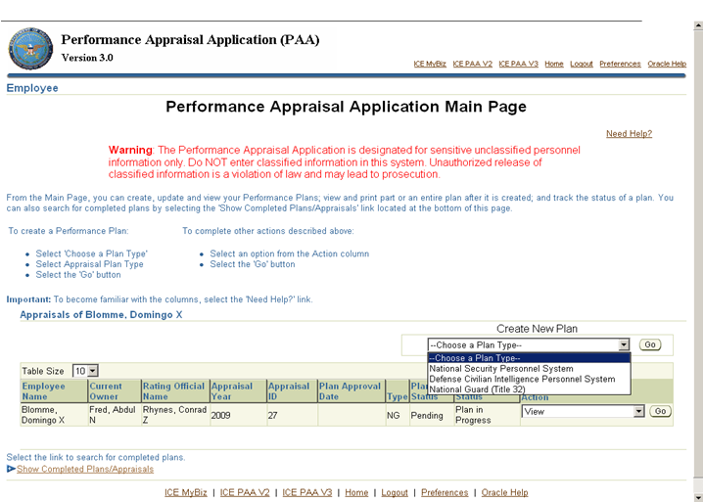
Create My Performance Plan
The Need Help link will give you information on what is available on the page where you are located.
This table includes information on the status of existing plans. From this screen you can view and update existing plans.
To create a new Performance Plan:
Select Choose a Plan Type
Select National Guard (Title 32)
Select GO

Slide 31
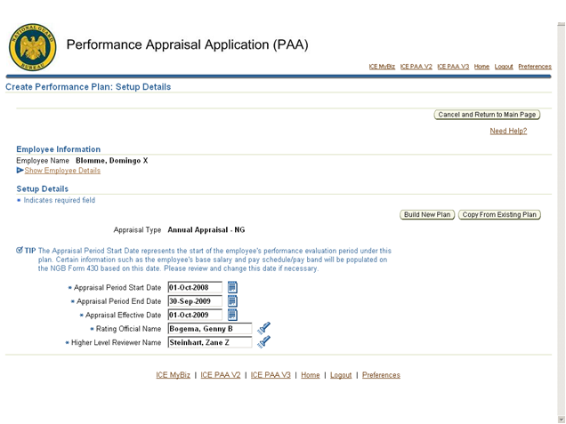
Create My Performance Plan
Select Build New Plan or Copy an Existing Plan button.
Select the Calendar to change dates or the Flashlight to change rater.
Notes:
Idaho will have to change the dates to reflect 01Jan – 31 Dec
If the Rating Official or Higher Level Reviewer is not listed as a Manager or Supervisor, he/she will not receive information because he/she will not have access to My Workplace

Slide 32
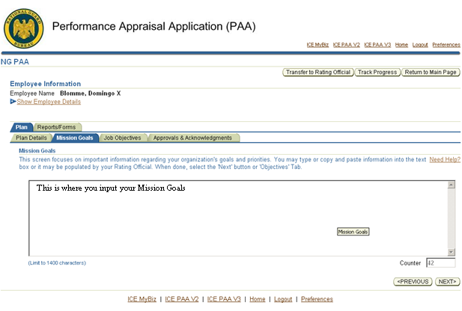
Add Mission Goals
You may copy and paste or type your Missions Goals
Counter
1400 Character Limit
Notes:
This is not required but highly recommended

Slide 33
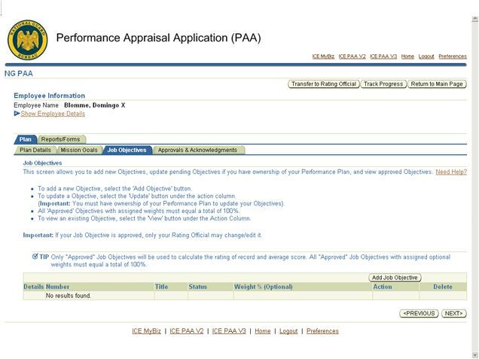
Add Job Objectives
Select Add Job Objective
Select Next
Notes:
Job Objective and Critical Elements are the same.

Slide 34
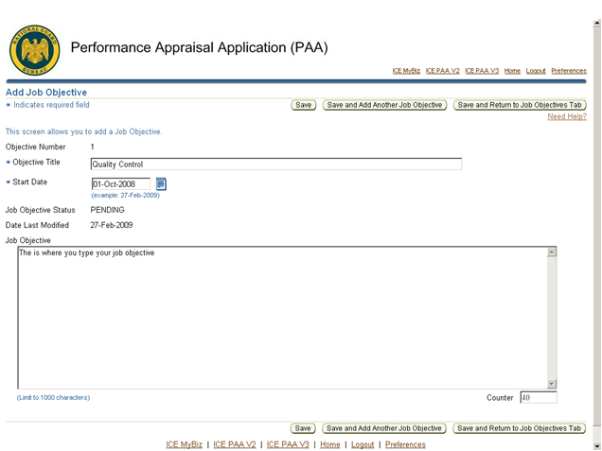
Add Job Objectives
The Job Objective Number auto populates
You can change the start date to reflect the period of performance
You may copy and paste or type your Job Objective
Notes:
Start date should read 01 Jan for current employees start date
This information can be copied and pasted directly from current employee performance standards.

Slide 35
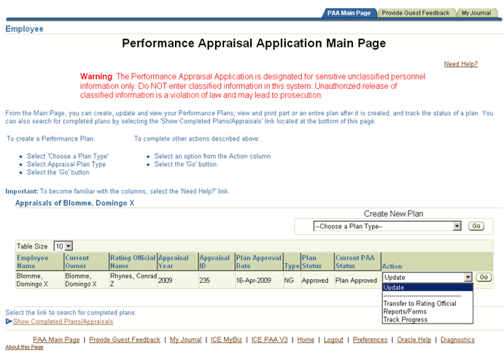
Transfer Performance Plan
Select Transfer to Rating Official and Select Go
Notes:
This is where the Employee, or the Rating Official would transfer it to the next level. This view is what an employee would see. The Rating Official will have the option to “Transfer to Higher Level Reviewer”

Slide 36
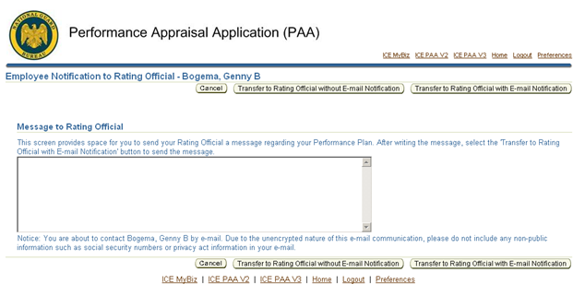
Transfer Performance Plan
Select Transfer to Rating Official
Type e-mail message
Notes:
This is the reason the email updates are important. Idaho requires that the Email notification always be used.

Slide 37
From: Prosser, Paula L
To: Jones, Nancy E.
Sent: 29-APR-2010 at 09:54:12
Appraisal ID: 22155
Performance Plan for Prosser, Paula L has been transferred to you and needs your attention.
Comments:
My job objectives have been completed for your review and approval
Click the link provided below to access the Defense Civilian Personnel Data System portal page to log in and access the Performance Appraisal
Application (PAA): NG https://compo.dcpds.cpms.osd.mil
If this link does not work, follow these steps:
1. Open a Web browser window.
2. Copy and paste the entire Web address into the location or address bar of
the browser.
3. Press enter.
Please Do Not Reply to this Email
Classification: UNCLASSIFIED
Caveats: FOUO

Slide 38
From: Prosser, Paula L
To: Jones, Nancy E.
Sent: 30-APR-2010 at 12:26:42
Appraisal ID: 22155
Prosser, Paula L has retrieved their Performance Plan/Appraisal.
You no longer have ownership of the performance plan/appraisal.
Click the link provided below to access the Defense Civilian Personnel Data System portal page to log in and access the Performance Appraisal Application (PAA):
NG https://compo.dcpds.cpms.osd.mil
If this link does not work, follow these steps:
1. Open a Web browser window.
2. Copy and paste the entire Web address into the location or address bar of the browser.
3. Press enter.
Please Do Not Reply to this Email

Slide 39
TRACK PROGRESS
Select Track Progress of plan and select Go

Slide 40
TRACK PROGRESS
Shows status of performance plan
Notes:
An employee, rating official and/or high level reviewer all now have the ability to see where the performance plan, interim review and/or assessment sit.

Slide 41
REPORTS/FORMS
Select Reports/Forms and select Go

Slide 42
REPORTS/FORMS
Select View/Print Form
Select Reports/Forms and select Go

Slide 43
NGB 430 in REPORTS/FORMS
View Signatures and Dates

Slide 44
Important Specifically to Idaho
Converting from a 3-Level System to a 5-Level System
Appraisal Period 01 Jan – 31 Dec
All Technicians need a Closeout Appraisal with an ending date of 31 December 2011
New Performance Plan input into PAA by
31 January 2012
Mandatory Supervisor Critical Element
Addition of a Mission Statement to all Performance Plans
Notes:
Appraisal Period Applies to Army and Air
Technicians that don’t have 120 days- Contact Lt Davis at HRO

Slide 45
QUESTIONS

